Slide 1


UNNATI SAXENA Data Science intern at Oasis Infobyte

Slide 2

TASK 4 EMAIL SPAM DETECTION WITH MACHINE LEARNING

Slide 3
We’ve all been the recipients of spam emails before. Spam mail, or junk mail, is a type of email sent to a massive number of users at one time, frequently containing cryptic messages, scams, or phishing content. In this project, Python was used to build an email spam detector. Then, use machine learning to train the spam detector to recognize and classify emails into spam and non-spam, Let's get started!

Slide 4
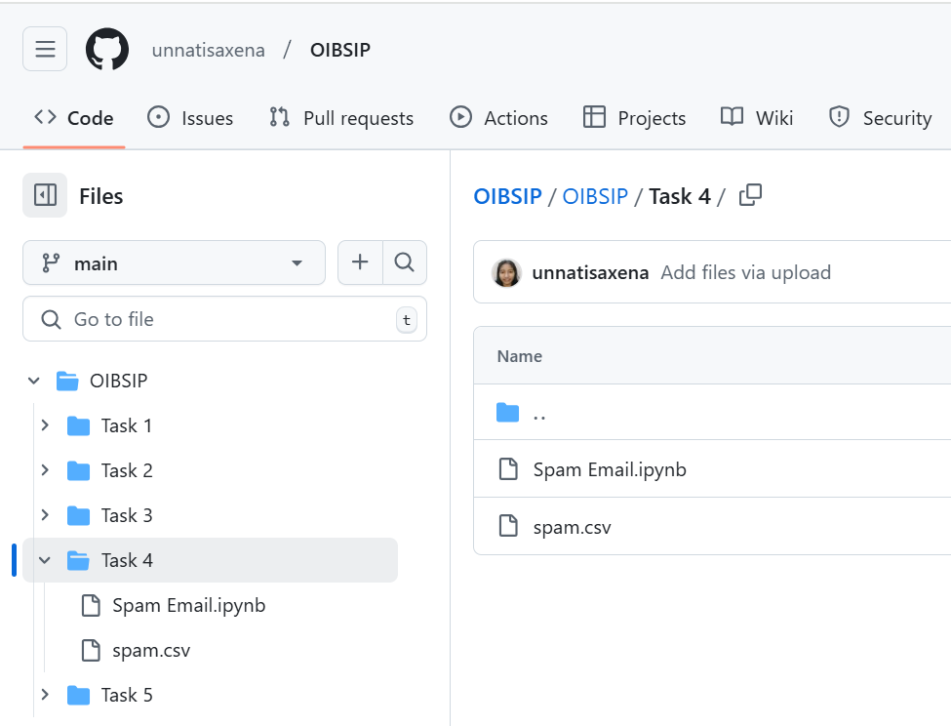
CHECK THE CODE IN THE GITHUB REPOSITORY https://github.com/unnatisaxena/OIBSIP

Slide 5

Questions? Let me Know. LinkedIn: https://www.linkedin.com/in/unnatisaxena/

